Slide 1
BajaaNa (A Music Player)
Aesha Shah
Badal Singh Rathore
Bhavya Patel
Sakshi Gurbani
Sarthak Khandelwal

Slide 2
Next Slides Include:
Objective
Approach
Difficulties faced
Learnings
Future scope

Slide 3
Objective
Create a music player with two web pages: One page for listing all available songs and another for playing the selected song with controls for play, pause, rewind, and looping.
Ensure continuous playback experience: The song should resume from the same position where it was last stopped, providing a seamless listening experience.

Slide 4
Approach
Initial Setup: Created a basic web page listing all available songs in a simple format, and a second page for playing the selected song with basic controls like play, pause, and volume adjustment.
UI Enhancement for Better User Experience: Enhanced the interface by adding advanced controls such as rewind and loop, improving the overall interactivity of the music player.
Card-Based Layout for Song List: Replaced the plain song list with a more visually appealing card layout, each card showcasing the song’s poster, name, and artist for a cleaner design.

Slide 5
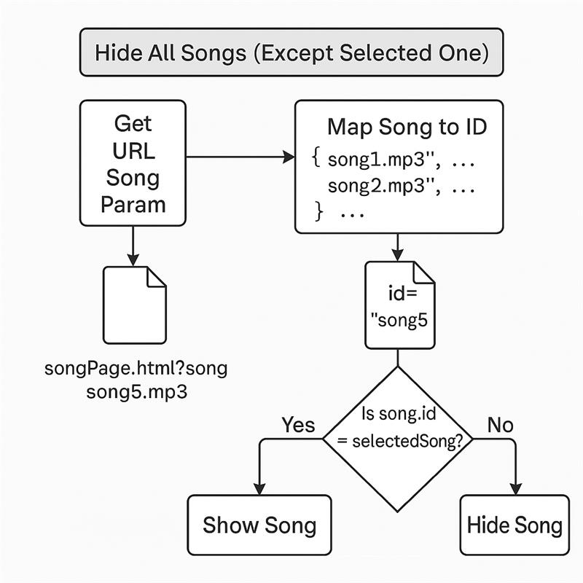

Slide 6
Difficulties faced
Lack of Knowledge in HTML, CSS, and JavaScript: Our limited understanding of HTML, CSS, and JavaScript made implementing dynamic features and audio controls more challenging.
LocalStorage Issues: Accurately saving and retrieving the song’s position from localStorage posed challenges when managing multiple songs.
Learning URL Parameter Handling: Figuring out how to pass and retrieve data via URL parameters took additional research and time, but allowed us to show the correct song.

Slide 7
Valtech Mobility Presentation Template
Learnings
Working with media: Handling audio files with the audio tag and controlling playback using JavaScript (play(), pause(), currentTime).
CSS : Learn some css property which we have used in the project.
LocalStorage management: Learn about how we can store the music duration and how we can manage it.

Slide 8
Valtech Mobility Presentation Template
Future Scope
Albums Category: Organize songs into albums with album artwork, making it easier for users to browse and find their favourite tracks.
Favorites Feature: Allow users to mark songs as favorites for quick access, creating a personalized playlist of their top tracks.
Custom Playlists: Enable users to create, manage, and customize playlists with drag-and-drop features for a more personalized music experience.

Slide 9
Valtech Mobility Presentation Template
Project Demo

Slide 10
Valtech Mobility Presentation Template
Project Demo

